Slide 1
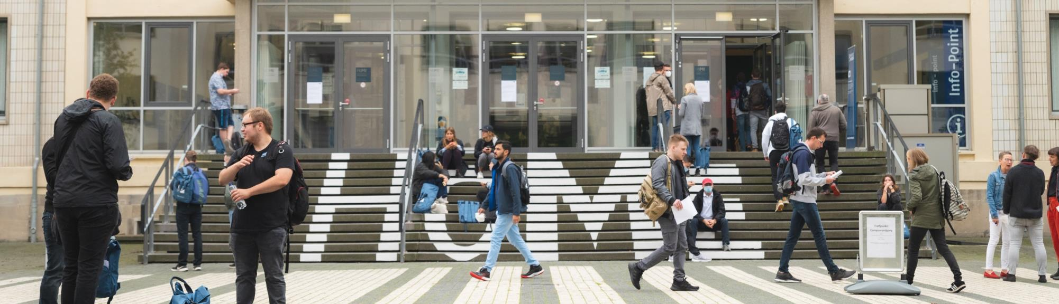

Merseburg University
of Applied Sciences
Let us introduce ourselves

Slide 2
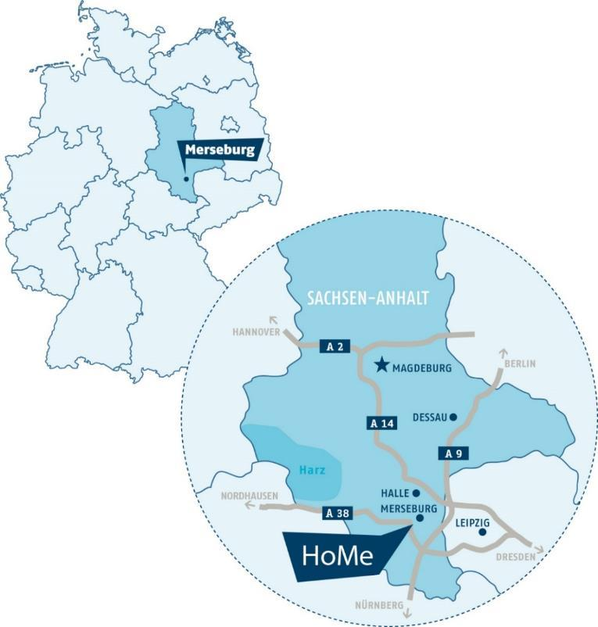
Where is Merseburg located?
Merseburg is a cathedral and university town on the river Saale in southern Saxony-Anhalt. It is the administrative seat of the Saale district and is part of the cross-border conurbation of the cities of Leipzig and Halle. The direct proximity of Merseburg University of Applied Sciences to the state-of-the-art industrial chemical plants in Leuna and Schkopau ensures a direct link between theory and practice at the university.

Slide 3
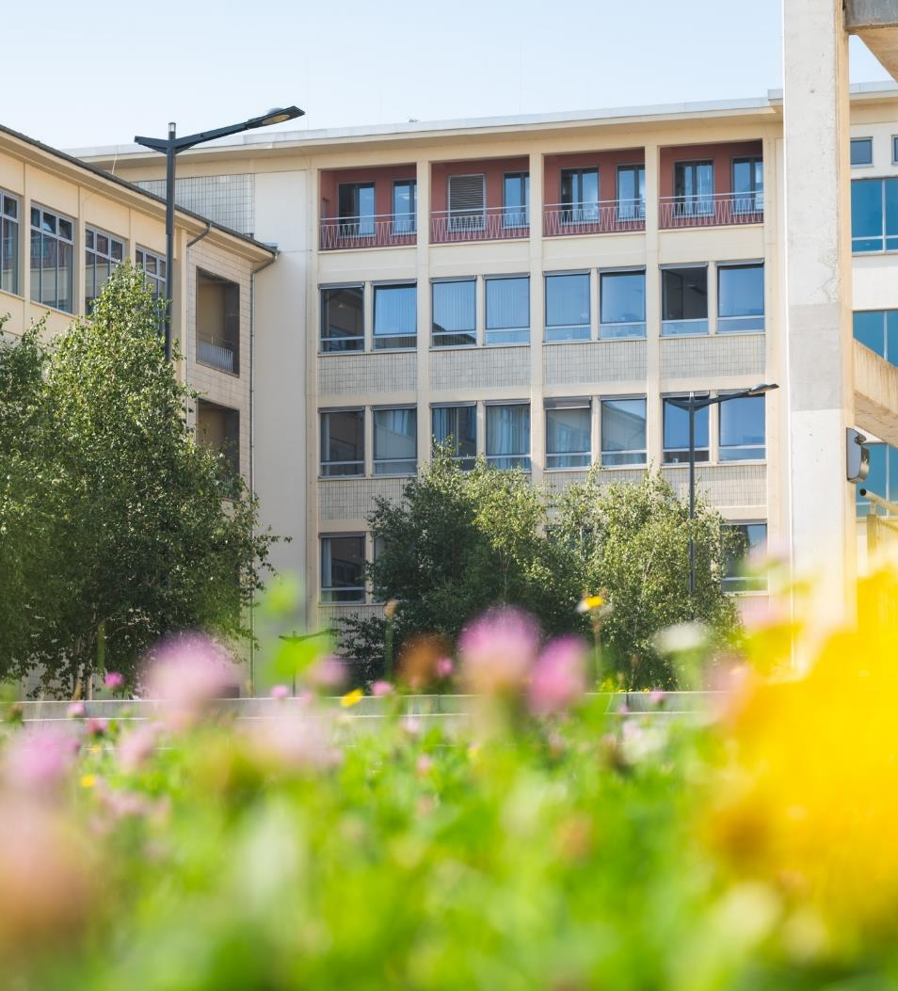
Merseburg University of Applied Sciences
Merseburg University of Applied Sciences was founded on April 1, 1992 as Fachhochschule Merseburg and has borne the name Hochschule Merseburg since 2004. It is located on the campus of the former Technical University
"Carl Schorlemmer" Leuna-Merseburg (1954–1993). Today it is successful in the region and can hold its own in the competition among German universities.

Slide 4

Our vision
Our Mission
We shape a sustainable future with practice-oriented and solution-oriented science.
We study, teach and conduct application-oriented, true-to-life and interdisciplinary research in close cooperation with business and society.
We are the reliable and constructive partner, who shapes the social, cultural, economic and technical change in the Central German metropolitan region and is a driving force behind international development.

Slide 5
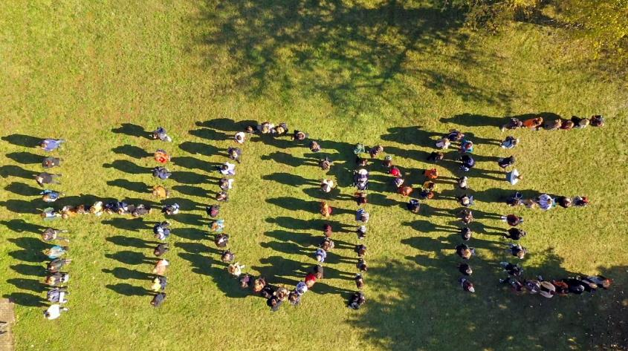
Our Philosophy
On our green campus, we offer a dynamic academic community, based on trust, in which competence, personality and personal responsibility can develop and thrive.
We communicate at eye level and encourage appreciative and fair cooperation.
We live in a family-friendly way, encouraging equal opportunity and gender sensitivity.
We are –
Merseburg University of Applied Sciences !

Slide 6
Merseburg University of Applied Sciences stands for:
Campus university with short distances
Personal support during your
studies – from your enrolment to the start of your professional life
Family-friendly university
Practical relevance and close cooperation with partners from the region
Laboratory equipment on the highest possible technical level
Excellent research in specialist and interdisciplinary fields
Promotion of the development of the region with partners from politics, business, administration and culture
Addressing economic, social and environmental challenges
Know-how from applied research with technology transfer, leads to direct practical applications in practice

Slide 7
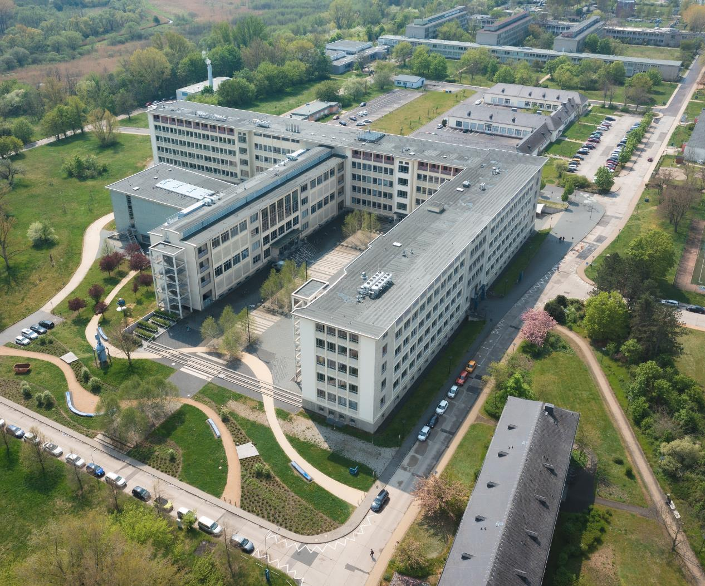
Campus
In a central position on
a green campus, Merse-burg University of Applied Sciences offers everything necessary for a successful and worth-while course of study: lecture halls, seminar rooms, laboratories and workshops, a library, a cafeteria, dormitories, sports facilities, student initiatives and the CampusKids daycare centre.

Slide 8
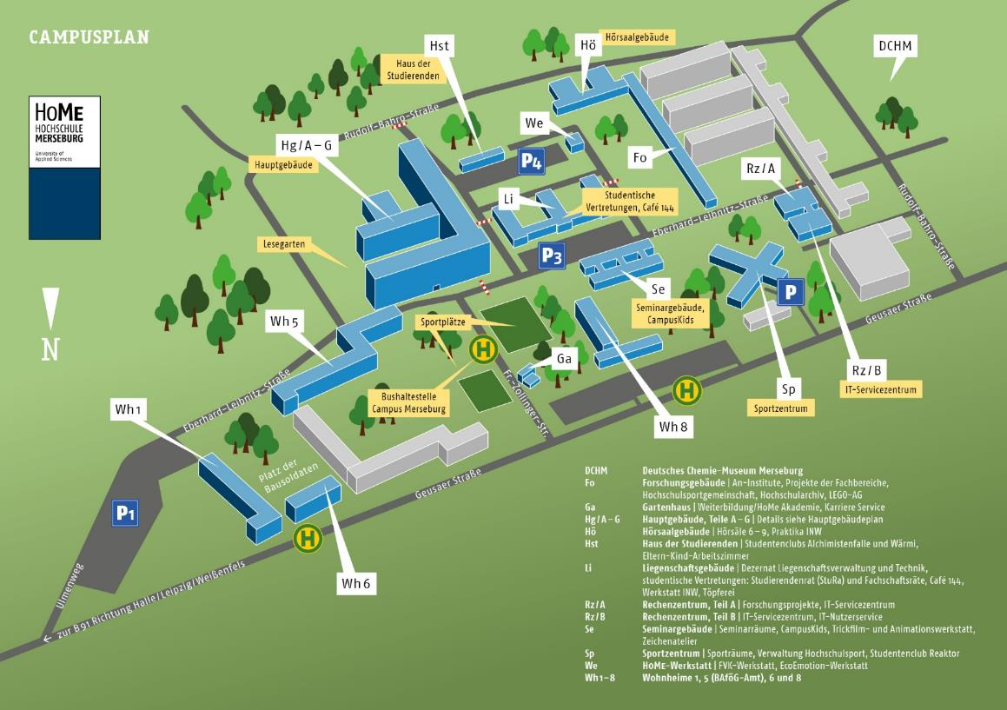
Campus Plan
Everything is located on
the Campus:
Lecture Halls
Seminar Rooms
Laboratories
Workshops
The Library
The Reading Garden
The Canteen and Cafébar
Dormitories
Sports Facilities
Student Club Wärmi
CampusKids Kindergarten
The Campus Theatre (TaC)

Slide 9
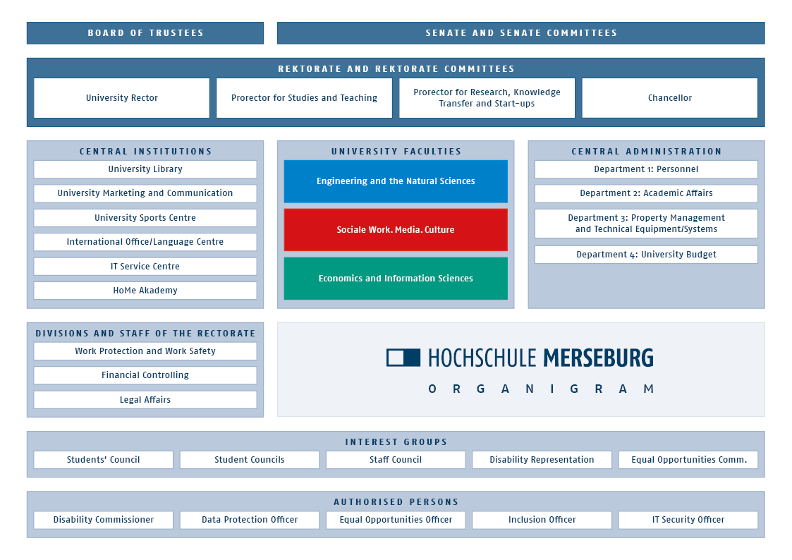

Slide 10
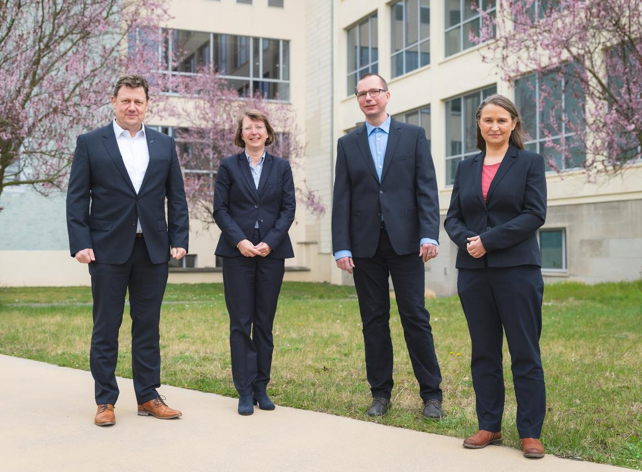
University Management
Prof. Dr.
Markus Krabbes
University Rector
Dr. Karen Ranft
Chancellor
Prof. Dr.
Heinz-Jürgen Voß
Prorector for Studies and Teaching
Prof. Dr. Doreén Pick
Prorector for Research, Knowledge Transfer and Business Start-ups

Slide 11

Studying
Approx. 3,000 students
More than 800 first semester students per year
Around 600 international students
Dual and part-time study opportunities
Support from mentors, e-tutors and study coaches at the beginning of and during study programmes
Small groups and good supervision are characteristic of university studies and contribute to success

Slide 12
Studying and Further Education
Broad range of courses
17 Bachelor Programmes
13 Master Programmes
KOMPASS –
The orientation semester
Numerous training opportunities
Range of courses
in three areas of expertise
Engineering and
the Natural Sciences (INW)
Social Work.Media.Culture (SMK)
Economics and Information Sciences (WIW)

Slide 13

Department of
Engineering and the Natural Sciences (INW)

Slide 14

Bachelor Programmes INW
B.Sc. in AI Engineering 7 semesters
B.Sc. in Applied Chemistry 7 semesters
B.Sc. in Applied Computer Science 7 semesters
B.Eng. in Chemical and Environmental Engineering 7 semesters
B.Eng. in Electrical Engineering and Automation Technology 7 semesters
B.Eng. in Engineering and Management (Engl.) 6 semesters
B.Eng. in Green Engineering 7 semesters
B.Eng. in Engineering Education 6 semesters
B.Eng. in Mechanical Engineering 7 semesters
B.Eng. in Technical Information Design 6 semesters
B.Eng. in Industrial Engineering and Management (dual) 7 semesters

Slide 15
Master Programmes INW
M.Eng. in Automation Technology and Informatics 3 semesters
M.Eng. in Mechanical Engineering 3 semesters
M.Eng. in Sustainable Process Engineering and Chemistry 3 semesters
M.Sc. in Polymer Materials Science (Engl.) 4 semesters

Slide 16
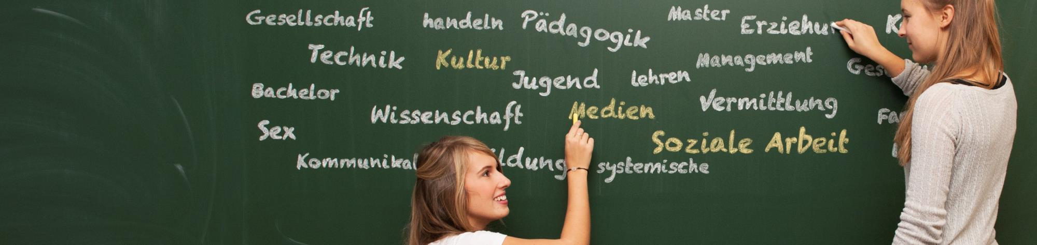
Department of
Social Work.Media.Culture (SMK)

Slide 17
Bachelor Programmes SMK
B.A. in Cultural and Media Education 6 semesters
B.A. in Social Work 6 semesters
Master Programmes SMK
M.A. in Applied Media and Cultural Studies 4 semesters
M.A. in Applied Sexology (Part-time) 6 semesters
M.A. in Sexology (Part-time while working) 7 semesters
M.A. in Systemic Social Work (Part-time) 6 semesters

Slide 18

Department of
Economics and Information Sciences (WIW)

Slide 19
Bachelor Programmes WIW
B.A. in Business Administration 7 semesters
B.A. in Business Administration (Part-time). 9 semesters
B.Sc. in Business Information Technology 7 semesters
B.Sc. in Industrial Eng. and Management (Focus on Managem.) 7 semesters
Master Programmes WIW
M.Sc. in Controlling and Management 3 semesters
M.A. in Information Design and Media Management 4/6 sem.
M.A. in Project Management 3 semesters
M.Sc. in Industrial Engineering and Management 3 semesters
M.Sc. in Business Information Technology 3 semesters

Slide 20
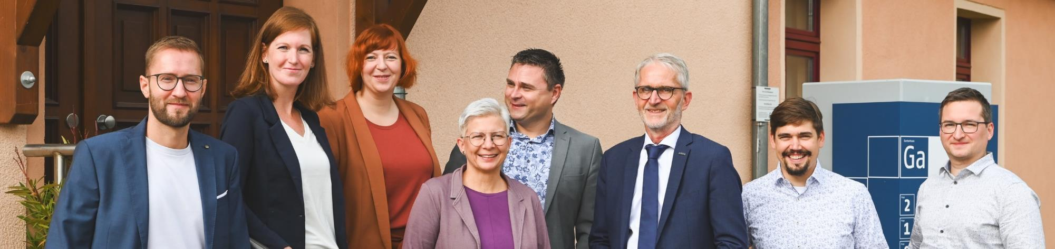

Further Education/HoMe Academy
An Interdisciplinary and Cross-Departmental Platform for Further Education
For professionals and companies or institutions
For the students and staff of Merseburg University of Applied Sciences
For schoolchildren and senior citizens

Slide 21
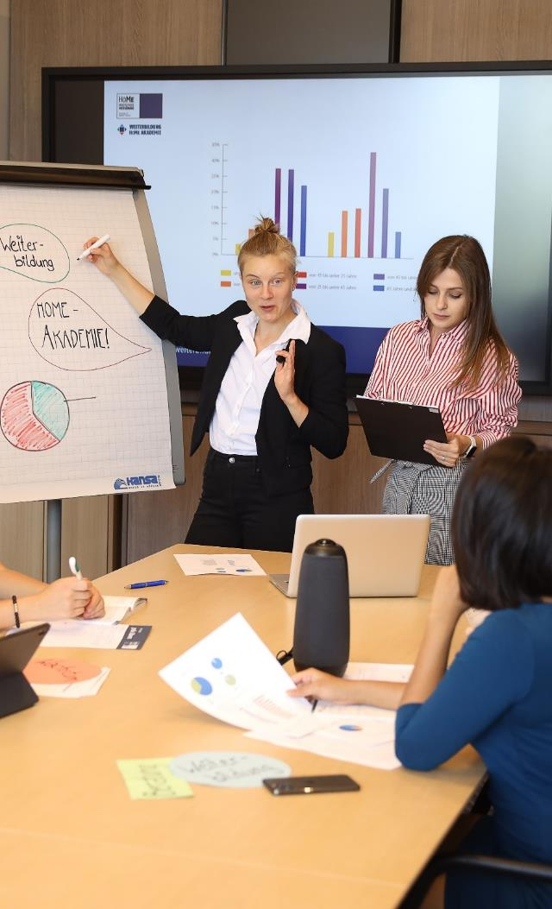
Further Education/HoMe Academy
Further Education
Part-time Bachelor and Master Programmes
Cooperative Degree Programmes, Cooperative Interconnected Model
Module and Certificate Programmes
Lectures and Seminars
In-house Seminars
Staff Training
Knowledge Management
Conferences
Projects
H₂HUB in Saxony-Anhalt
Future Centre of Digital Work Saxony-Anhalt

Slide 22

General Admission Requirements
General university admission qualification or
Advanced technical college entrance qualification or
Subject-related higher education entrance qualification or
Vocational further training qualifications entitling holder
to study (e.g. Master craftsman, Master technician) or
HoMe assessment test: subject-based university admission for professionally qualified persons with an intermediate school-leaving certificate + full vocational training + 3 years of work experience
International students: please check our international website
for admission requirements

Slide 23
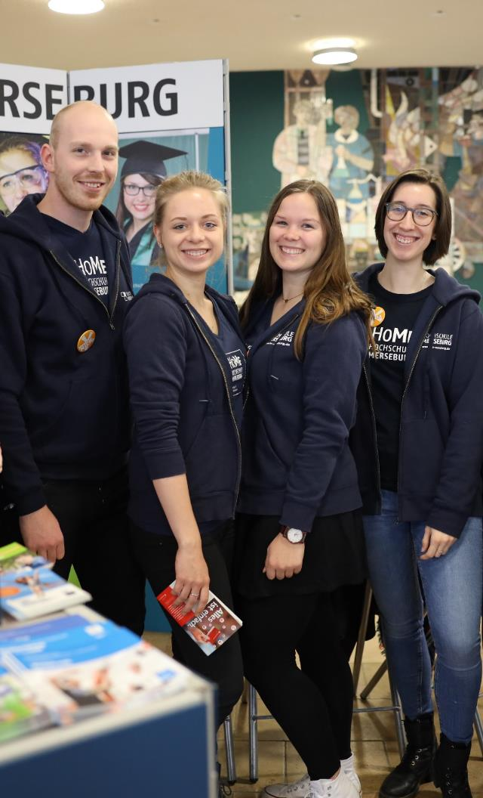
Study orientation
Various all-year-round and free programmes
Taster studies several times a semester
Study orientation events for school classes
Girls' Day and Boys' Day programmes
University Open Day
Information at education fairs
General study counselling and advice on subject
of degree course
Campus tours
Parents‘ Evenings at Schools

Slide 24
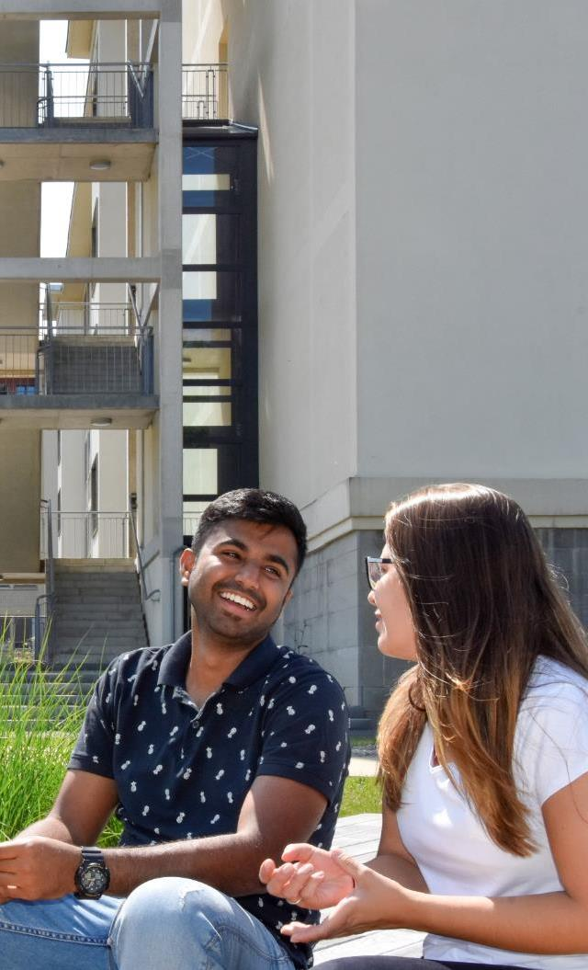
Study Abroad/
International Students
Cooperation partners in around 40 countries around the world
Advice and support for students regarding
  Studying abroad
  An internship abroad
  Participation in International Weeks and summer schools
Language courses in English, French, German, Russian and Spanish
Intercultural Competence Certificate
Buddy-Service and International Office

Slide 25


HoMe Start-up Service
Generating ideas
Start-up consultation and support
Subsidies and financing
Property rights and utilisation strategy
Networking
With events, mentoring and coaching "Step by step to your own business"

Slide 26

Research, Transfer and Promotion of Young Researchers and Scientists
Regional roots – operating internationally – committed to sustainability
Providing an impulse for the region

Slide 27
Research, Transfer and Promotion of Young Researchers and Scientists
Excellent research on pressing issues: development of solutions to current societal challenges in our main areas of research: Sustainable Processes and Digital Change
We are a member of the Competence Network for Applied and Transfer-Orientated Research (KAT): we do research together with and for organizations and companies in the local area.
Our university promotes start-ups: we help found new businesses by providing advice and support for start-ups.
We support young academics and scientists: we keep academic talent in the region by providing advice and support.
CASE project for the development and recruitment of professorial staff (federal-state initiative FH Personal, 2021–2027)

Slide 28


Our interdisciplinary research focus
Processes
Our aim is to support the reorientation of the economy and society and to help shape the transformation towards sustainability.
Here sustainability must be seen as a concept based on three equally important pillars: environmental compatability, social justice and economic efficiency.
Digital Change
The aim is to bundle research
efforts around digital technologies in an interdisciplinary way, thus driving forward development in the region.
In accordance with our profile lines, the main focus will be on the numerous possibilities of Industry 4.0 in the key areas of life, work and technology which are all equally important.

Slide 29
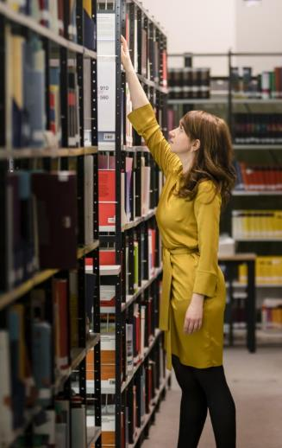
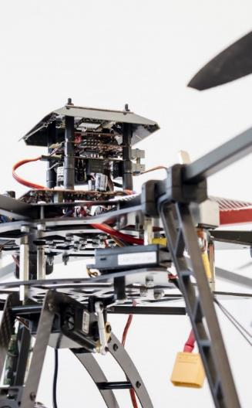
HoMe Research Promotion Centres
Are pioneering, i.e. universities of applied sciences in Saxony-Anhalt have had the right to award doctorates independently
since May 2021
HoMe participates in the activities of two out of a total of five inter-university doctoral centres
Doctoral Centre for Social, Health and Economic Sciences (SHE) run by the universities of Merseburg, Anhalt, Harz and Magdeburg-Stendal
Doctoral Centre for Engineering Sciences and Information Technologies (ESIT) run by Merseburg, Anhalt and the Harz University of Applied Sciences
Expansion of practical doctorates with cooperation partners from industry and the public sector
Doctorates in cooperation with other universities are still possible

Slide 30
Cooperation and Support
Industrial Enterprises
DOMO Caproleuna
Dow Buna Sow Leuna Olefinverbund
enviaM Mitteldeutsche
Energie AG
GISA
InfraLeuna
Leuna-Harze
MIBRAG
MITNETZ Mitteldeutsche Netzgesellschaft Strom
MOL Katalysatortechnik
Relaxdays
Rotkäppchen
SONOTEC
TotalEnergies Raffinerie Mitteldeutschland
Trinseo Deutschland
Academic and Scientific Institutions
Hochschule Anhalt
Hochschule Harz
Hochschule Magdeburg-Stendal
Hochschule für Kunst und Design Burg Giebichenstein
IHK-Bildungszentrum
Halle-Dessau
IMWS Fraunhofer-Institut für Mikrostruktur von Werkstoffen und Systemen
Martin-Luther-Universität Halle-Wittenberg
Otto-von-Guericke-Universität Magdeburg
UFZ Helmholtz Zentrum für Umweltforschung Leipzig
Umweltbundesamt
Educational Institutions, Public Institutions, Associations, Sport
Agentur für Arbeit
Sachsen-Anhalt Süd
Bildungsverbund Chemie und Technik Halle
Handwerkskammer Halle
IHK-Bildungszentrum
Halle-Dessau
MITZ Merseburger Innovations- und Technologiezentrum
Saale Bulls – Mitteldeutscher Eishockey Club Halle
Saalesparkasse
Staatl. anerkanntes Studienkolleg Halle-Merseburg
Studienkolleg der Rahn-Education
SYNTAINICS MBC
Techniker Krankenkasse

Slide 31
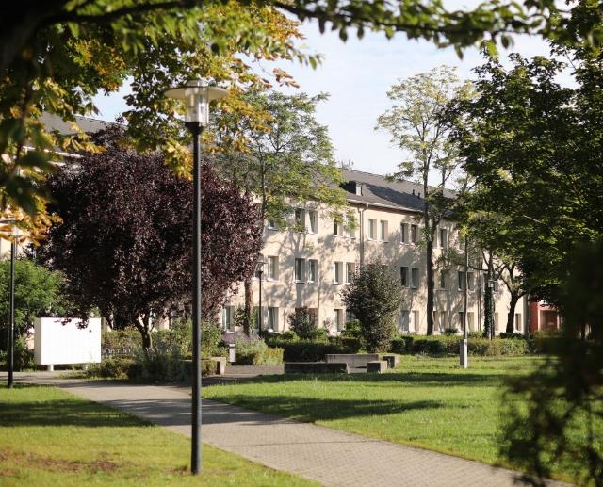
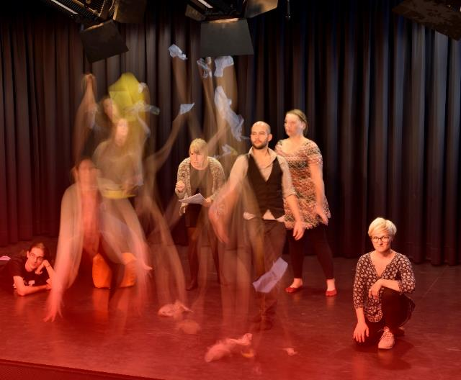
Student Life and Accommodation
Multicultural, green campus with modern dormitories
Large sports centre with fitness rooms,
sports fields and a wide range of courses
Student Initiatives and Wärmi Student Club
Students‘ Associations
Campus Theatre
Campus Cinema
Campus Fête and University Ball
Research daycare centre CampusKids (Student Union Halle)
Student life/accomodation in Merseburg, Halle or Leipzig

Slide 32
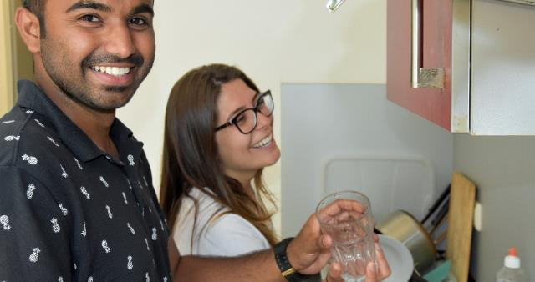
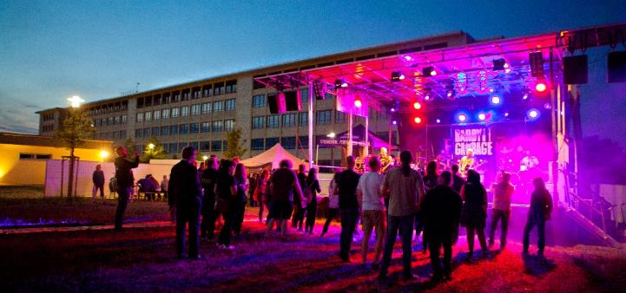
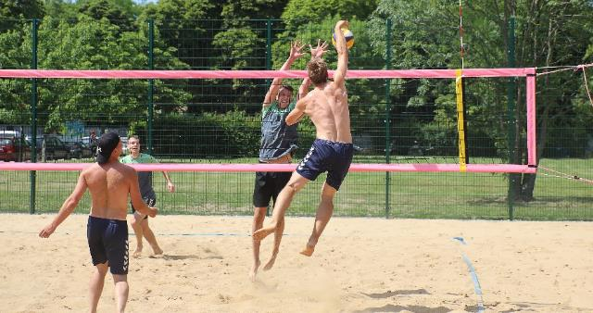
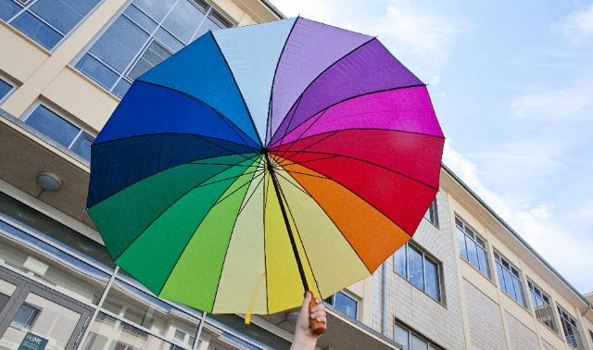
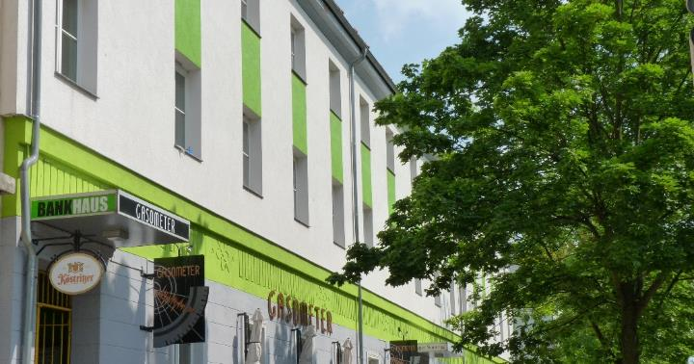
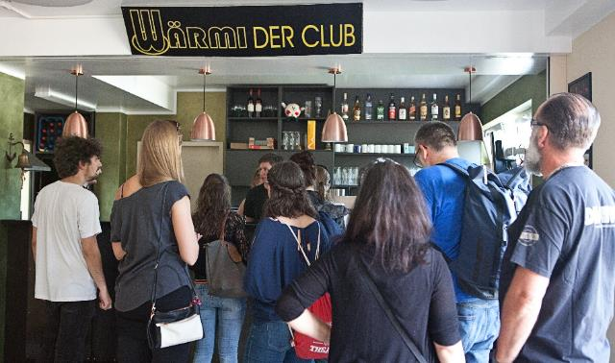
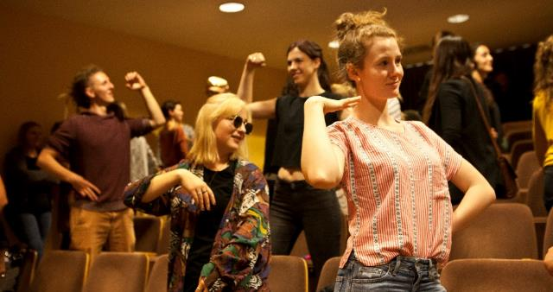
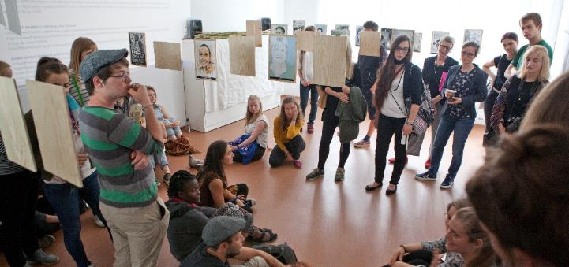


Slide 33


Family-Friendly University
Awareness raising, information and advice
Lectures and workshops
Family-friendly study and working hours
Childcare provided by the CampusKids research daycare centre (Student Union Halle)
Parent-Child Workroom
Game boxes for hire
Play corner in the canteen
Welcome Kit

Slide 34
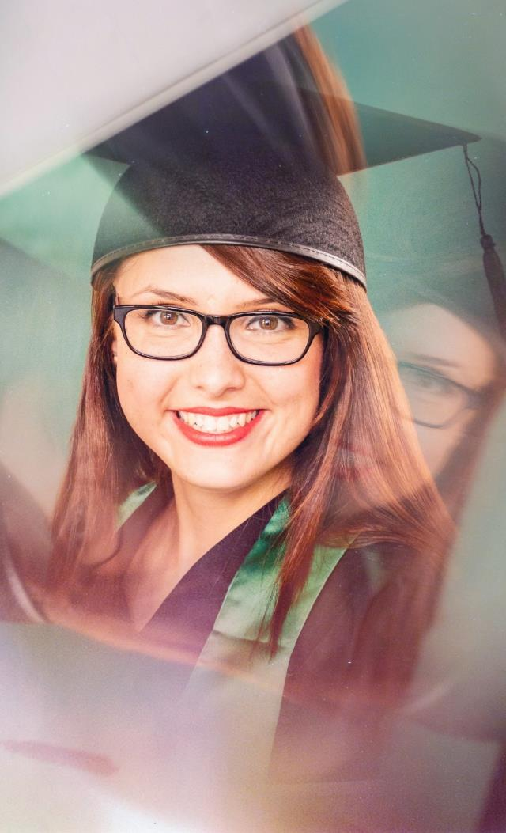
Keep in touch. Alumni of Merse-burg University of Applied Sciences
Alumni fireside chat
Meetings of Alumni from all disciplines
Invitation to the University Ball
Weekend campus tours for Alumni meetings
HoMe Alumni networks
(Alumniportal, XING, LinkedIn)
Publication of Alumni Portraits
Career placement and customized further training programmes

Slide 35
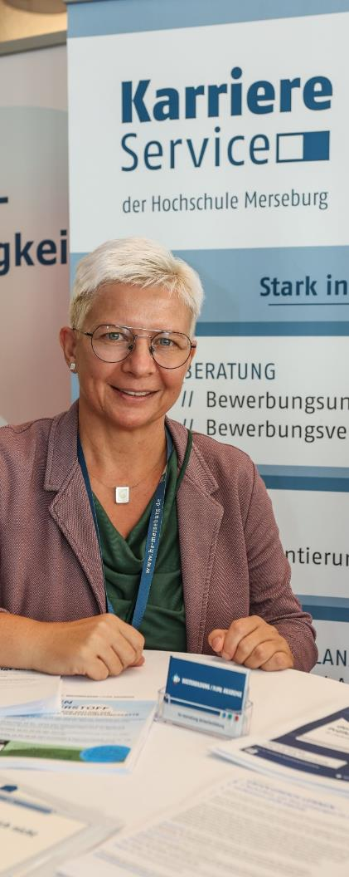
Career Service
Shaping careers, building networks, experiencing success
Mediation and networking between students, graduates, alumni, returnees and regional companies
Job acquisition and placement (internships, Bachelor and Master theses, job offers), Stellenportal@HoMe
Company contact fair, networking events with regional companies
DNLA Potential measurement procedure and competence assessment procedure
Informantion and counselling on career planning

Slide 36

Working at Merseburg University of Applied Sciences
Crisis-proof, future-orientated and with numerous advantages in everyday working life, including:
Union Wages, 30 Days of Paid Vacation
Flexible Working Hours, Home Office
Company Pension Plan
Wide Range of Further Training Opportunities
Mensa and Cafeteria
Needs-based Child Care
Modern University Sports Centre
Apply now!

Slide 37
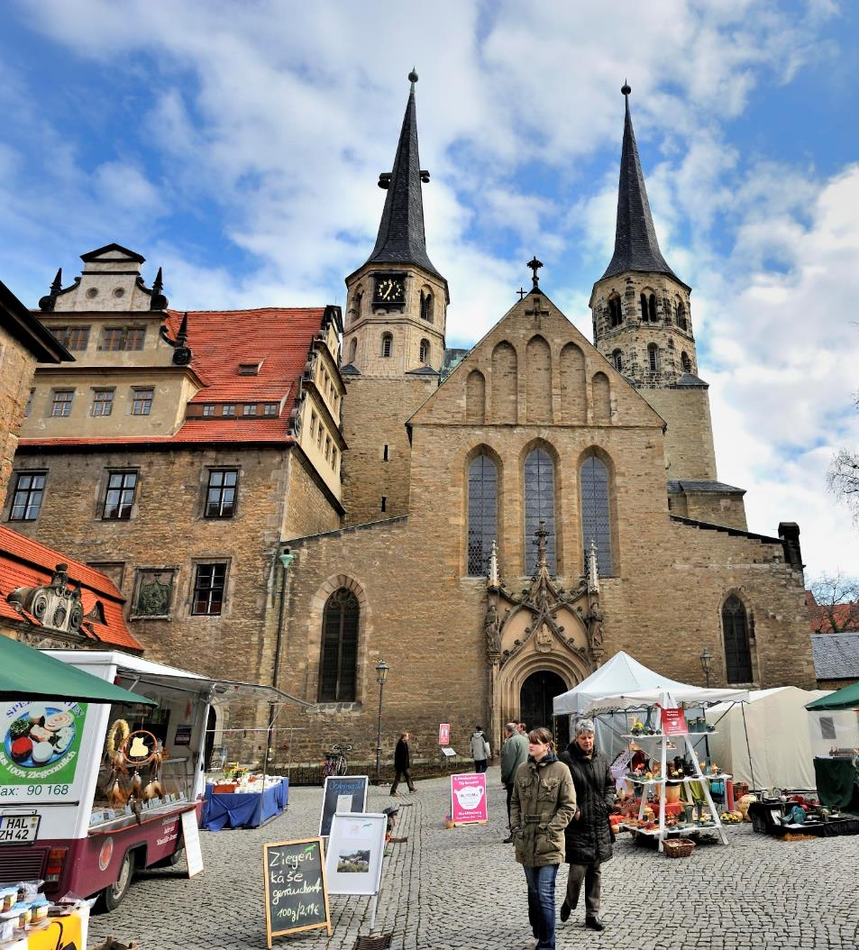
City of Merseburg
A thousand years of history are
to be discovered at every turn.
The Gothic cathedral and Renaissance palace sit enthroned above the Saale in a unique architectural unity and Merseburg's museums and galleries are among the special tourist attractions.
Merseburg's culture is versatile and multifaceted offering something for everyone's taste and interests.

Slide 38
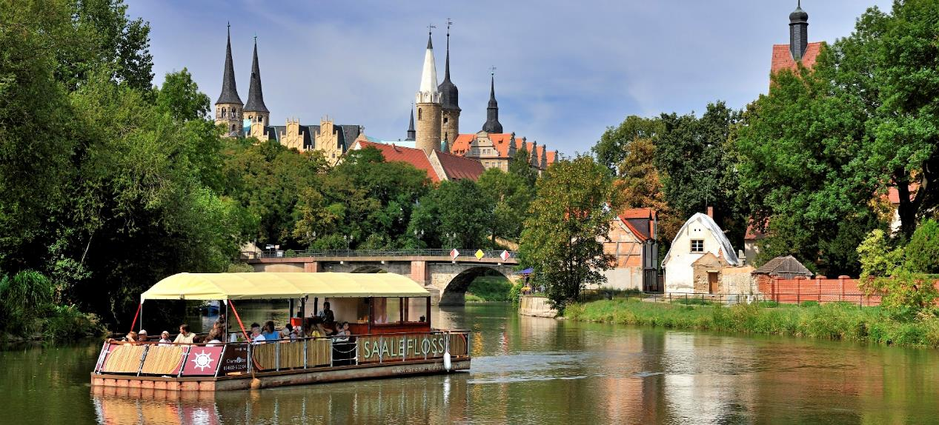
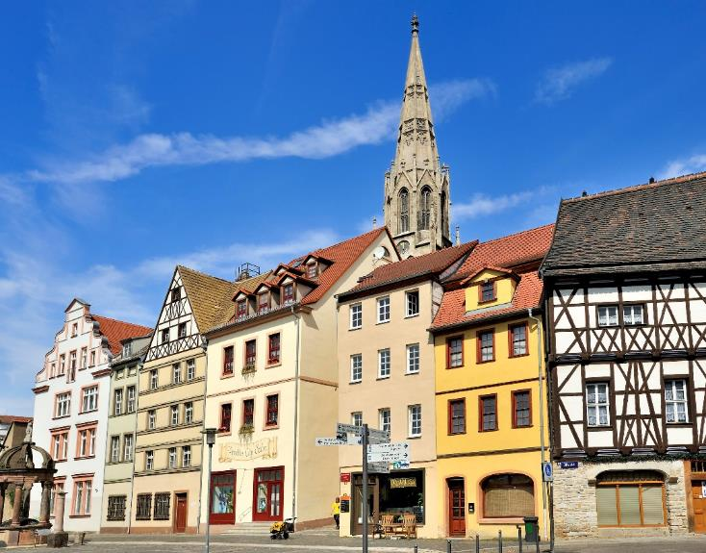
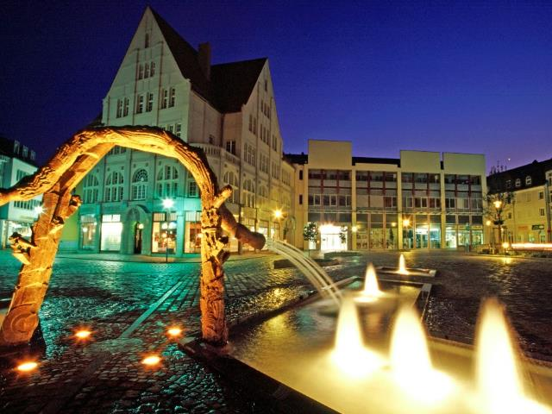
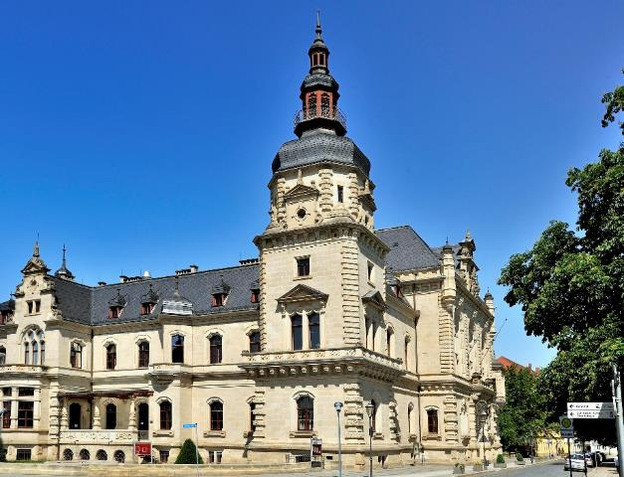
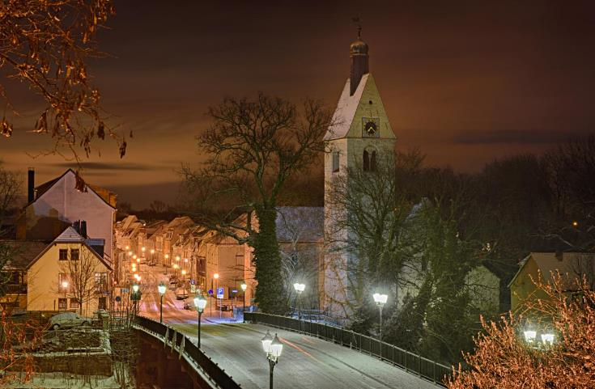

Slide 39
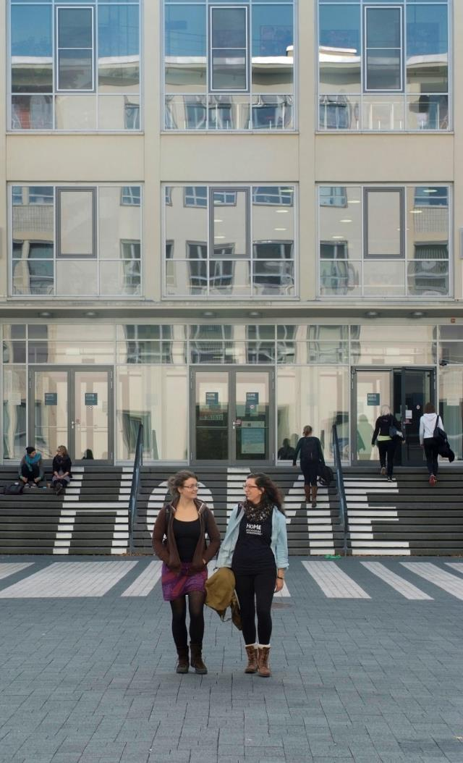
Contact
Hochschule Merseburg
Eberhard-Leibnitz-Strasse 2
06217 Merseburg
+49 3461 46–2840
marketing@hs-merseburg.de
www.hs-merseburg.de

